Slide 1
How to Access Information
Notes: View Add speaker notes to your slides to access the speaking notes of each slide. Complex slides have a description in the Notes Section in PowerPoint.
Alternative Text: All images have alt text. Please use the Notes Section for additional description and explanation.

Slide 2

Canvas Accessibility
L-I-S-T

Slide 3
Announcements
Would you and your peers benefit with a free deeper-dive into accessibility?
Three consecutive 1.5 hour Zoom sessions
Hands-on activities
Canvas & Video Accessibility
More sessions this week:
Tuesday (March 17), Wednesday (March 18), and Thursday (March 19)
Morning session: 9AM-10AM
Evening session: 6PM-7PM
More sessions next week!
Tuesday (March 24), Wednesday (March 25), Thursday (March 26)
Morning session: 10AM-11AM
Evening session: 3PM-4PM
Notes:
Request training: https://cccaccessibility.org/training/request-campus-training
More hours listed on: https://cvc.edu/about-the-oei/resources/

Slide 4
Your choices in formatting affect students
Here's a paragraph.
Here's a heading.
Here's a bulleted list:
Item 1
Item 2
<p>Here's a paragraph.</p>
<h2>Here's a heading.</h2>
Here's a bulleted list:
<ul>
<li>Item 1</li>
<li>Item 2</li>
</ul>
Notes:
On the right hand side is what a screen-reader will interpret.
The yellow highlighted items are tags. For example this <h2> represents a heading level 2. <ul> represents “unordered list”. <li>represents “Line Item.” Notice that tags help the screen-reader interpret the type of text. Is it a heading? Is this group of text a list? The screen reader need these tags to help the student understand how your text is formatted.
The screen reader will read aloud this heading 2 example as, “Heading 2 – Here’s a heading.” Notice how it will read out the type of text first. Then it will read the text.
A common question I hear from faculty is: Can I just increase the text size and bold my text so it looks like a headings?
Answer: No.

Slide 5
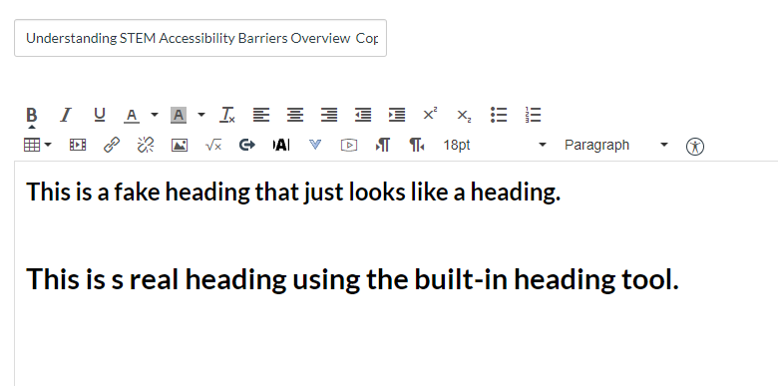
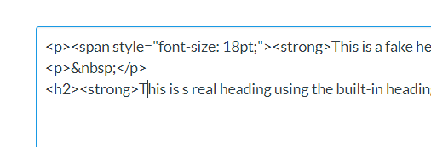
Your choices in formatting affect students
Notes:
If you look at the coding when we used the real heading 2, the tag is different: it’s <h2>.
Using the built-in rich content editor tools also saves you time. It takes more clicks to make text look like a heading.
Remember, how you format your content impacts your learners.

Slide 6
Use the built-in Canvas Rich Content Editor
Notes:
The good news is that you don’t have to be a website pro and memorize HTML coding and tags to create an accessible online course.
Leverage Canvas’ built-in Rich Content Editor. Use these tools to format your content.

Slide 7
L-I-S-T
Links
Images
Structure (Headings & Lists)
Tables

Slide 8
Today’s Learning Take-Aways
Write descriptive links
Apply alt text to images
Apply proper headings
Apply caption & table headers to tables
Determine video captioning workflow based on video authorship

Slide 9
Links: Descriptive & Meaningful
https://www.google.com/search?ei=U6s2XPGILN3C0PEP362dgAQ&q=writing+learning+objectives+&oq=writing+learning+objectives+&gs_l=psy-ab.3..0l10.5272.5272..6689...0.0..0.166.166.0j1......0....1..gws-wiz.......0i71.iQv74mRCgl0
Read Bloom’s Taxonomy to learn more about writing effective learning objectives.
Notes:
Or Option 2?
The second example, yes? What do you notice about the second example?
The hyperlink is describing to us where we are going. Screen readers will navigate multiple ways. Through the link list, through the headings list, by tables, etc.
The hyperlink is woven into a sentence to provide context and directions. Students need to know: what is this link about? Why is it important? Etc.

Slide 10
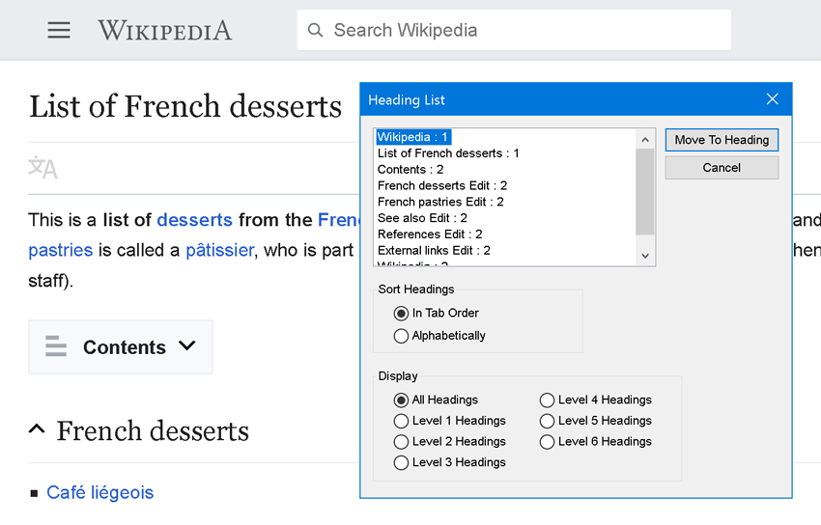
Screen Readers Navigate in Different Ways
Can pull up a list of:
Links
Images
Headings
Lists
Tables
Notes:
Screen readers can summon a list of all the links, images, headings, lists, and tables on a Canvas page. We will need to be careful to be as descriptive as possible so that our content makes sense in the stand-alone screen reader list.

Slide 11
Which examples are helpful?
Unacceptable
Appropriate
Click here to read the article.
Read our academic integrity policy – More Info.
Article 1 (Read More) | Article 2 (Read more)
Learn more about color and accessibility here and here.
Be sure to read our Academic Integrity Policy.
Article 1: The Fall of Man | Article 2: The Rise of Man
Learn more about color accessibility in terms of color contrast.
Notes:
I’m a student who is going to navigate with a screen reader now. I’m going to pull up the “Inappropriate” list and have my screen reader read aloud the link list. It would read aloud:
Click here
More info
Read more
Read more
Here
Here
Read aloud “Appropriate” list

Slide 12
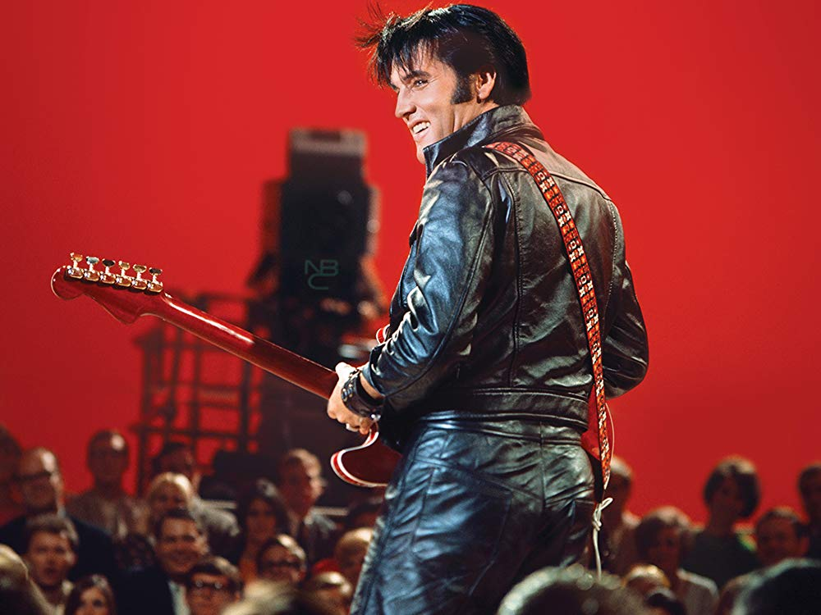
Write Alt Text …For a fashion history course…
Alt Text
Elvis Presley performing onstage in leather outfit.
On Canvas Page, weave in-depth description next to image:
Leather clothing was adapted from First World War aviation garb. Its first true rock n roll moment came from the silver screen when filmmakers tapped into youth culture in the delinquent films of the 1950s. Elvis famously wore an all leather outfit when he filmed his 1968 Comeback Special.
Notes:
Let’s think about the intention of our images. Why are we using them? How does it relate to the content?
Remember you are the author. Help your students understand the significance of your images and how they tie into the story you’re telling.
Because this is a complex image, I’ve included the alt text as a short description and on the Canvas page, I’ve also written an in-depth description next to the image (read the paragraph). This surrounding text provides:
additional information about the artist
the technique

Slide 13
Structure: Use built- in lists
Unordered list
Use bullets
Ordered List
Used when sequence is important
Notes:
This is easy.
When you are writing directions to students, which list would you use?
When you are listing materials needed for the course, where no particular ordered is needed, which list would you use?
Remember: Leverage Canvas’ built-in list button. Screen-readers will not be able to interpret groups of text with manual dashes.

Slide 14
Headers Reiterate Essential Topics
Background Information
In 1956, Benjamin Bloom with collaborators Max Englehart, Edward Furst, Walter Hill, and David Krathwohl published a framework for categorizing educational goals: Taxonomy of Educational Objectives. Familiarly known as Bloom’s Taxonomy, this framework has been applied by generations of K-12 teachers and college instructors in their teaching.
The framework elaborated by Bloom and his collaborators consisted of six major categories: Knowledge, Comprehension, Application, Analysis, Synthesis, and Evaluation. The categories after Knowledge were presented as “skills and abilities,” with the understanding that knowledge was the necessary precondition for putting these skills and abilities into practice.
While each category contained subcategories, all lying along a continuum from simple to complex and concrete to abstract, the taxonomy is popularly remembered according to the six main categories.
The Original Taxonomy (1956)
Here are the authors’ brief explanations of these main categories in from the appendix of Taxonomy of Educational Objectives (Handbook One, pp. 201-207):
Knowledge “involves the recall of specifics and universals, the recall of methods and processes, or the recall of a pattern, structure, or setting.”
Comprehension “refers to a type of understanding or apprehension such that the individual knows what is being communicated and can make use of the material or idea being communicated without necessarily relating it to other material or seeing its fullest implications.”
Notes:
Here is the page with headers.
Much more tangible, and you can easily navigate to sections of this text. This is not only helpful for your students who rely on screen-readers but for your visual learners as well.

Slide 15
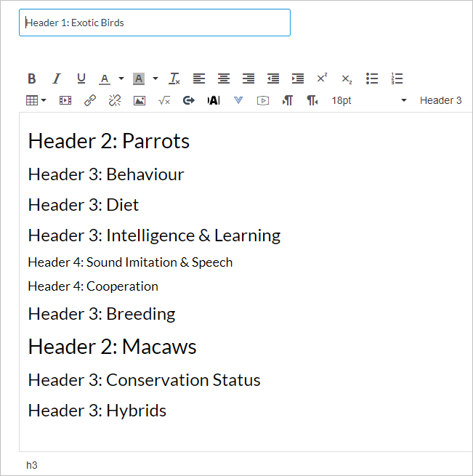
Headers = Outline
Notes:
Think of headings as an outline.
These examples use indentation for emphasis & text sizing
Students will understand how the main topics and subtopics are related to one another based on the size.
Think of H2 as a Main Topic
H3 and H4 are subtopics of the Main Topics

Slide 16
Multiple Header 2s (Main Topic)
Notes:
You have multiple Header 2’s. Remember think of Header 2s as ‘main topics.’

Slide 17
Multiple Header 3/4s (Subtopics)
Notes:
You may also have multiple Header 3s and 4s.

Slide 18
Don’t Skip Header Levels!
Notes:
Header levels must go in order as students will initially interpret the whole page with their assistive technologies. If one skips from Heading 1 to Heading 3, students may be confused looking for Heading 2.

Slide 19
Tables: Help Students Read Your Tables Logically
Caption
Plant Growth in Soils with Different pH Values
Table Header
Plant Group | Soil pH | Average Plant Growth (cm)
1 | 6.0 | 25.4
2 | 6.2 | 33.0
3 | 7.2 | 22.9
Notes:
Accessible tables have a caption and at least one table header. A caption is like the table title.
Table headers are needed to allow students who rely on screen-readers the opportunity to navigate the table.
Table header is the title of the data below.

Slide 20
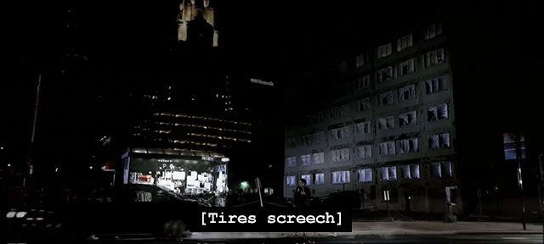
Captions
Notes:
What is the difference between subtitles and captions? Are they the same thing?
Answer: Subtitles serve as direct translation and captions capture all relevant sounds and dialogue.

Slide 21
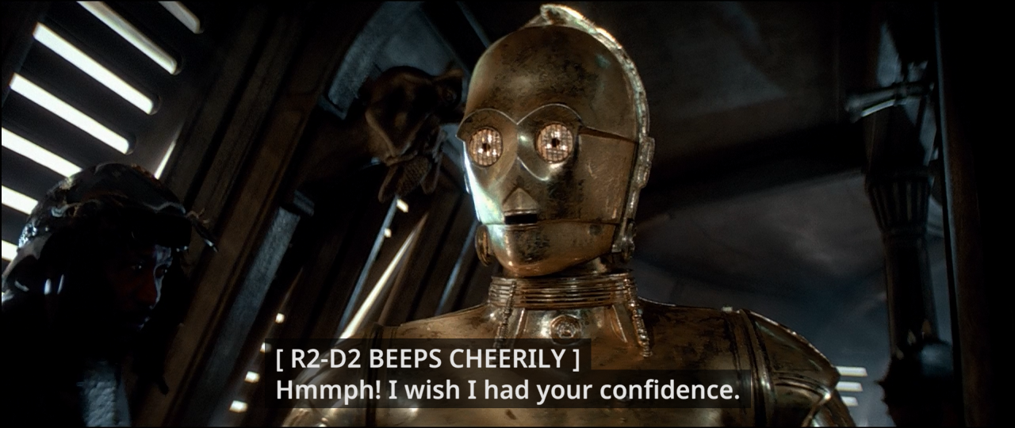
Accurate, Synchronized, Good Grammar & Punctuation
Notes:
Captions need to be accurate, synchronized, and have good grammar & punctutation.
Subtitles for the Deaf or Hard-of-Hearing (SDH) is a form of subtitles originating in America.
Captions are in the subtitle track.
Caption decoder may not be available

Slide 22
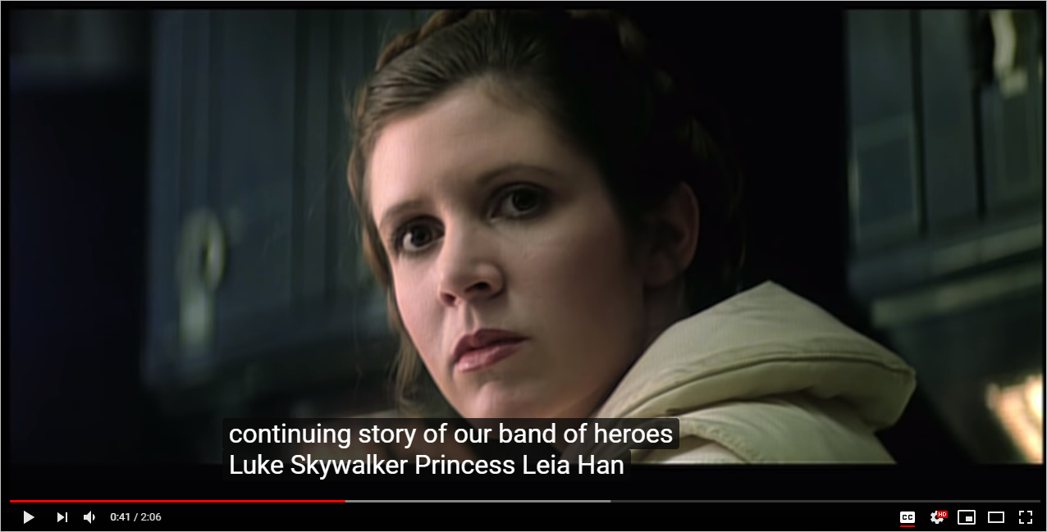
Auto-Caption: Let’s Leverage It!
Notes:
YouTube is great in providing auto-captioning that you can edit. Save time!

Slide 23
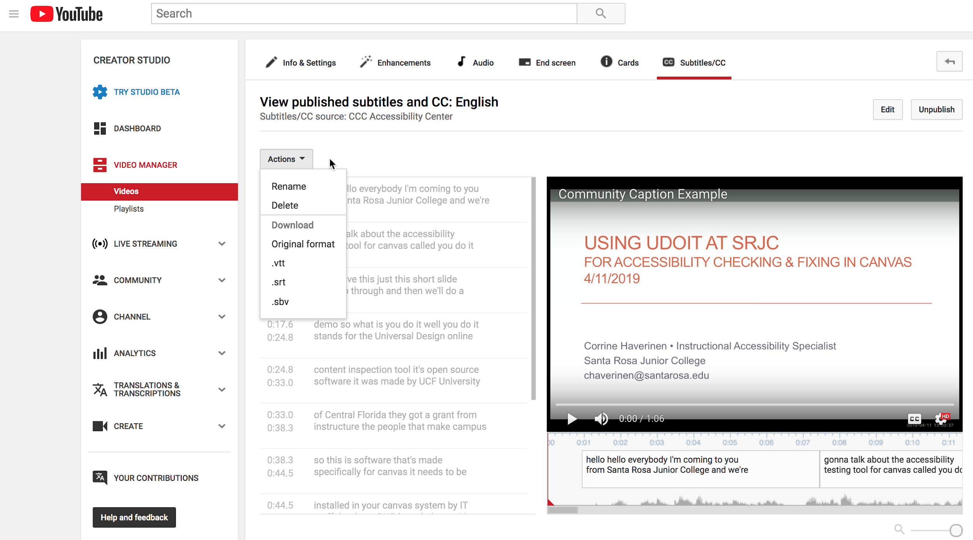
YouTube Classic Studio: For Videos You Own
Write a script of what you will say and relevant sounds in brackets. Add punctuation.
Record your video and read from your script.
Use YouTube’s Synchronize Transcript tool to sync your script and video sound. Adjust timing as needed. Done!
Notes:
For videos that you own, you can use YouTube Classic Studio to sync your video’s audio to your script. First you will want to Write a script of what you will say and relevant sounds in brackets. Don’t forget to add punctuation. This will save you a lot of time downstream. Next, record your video and read from your script. I know it may sound or feel weird at first when you read off a script. I totally get it. But eventually, I promise, it will become more natural with practice. Trust me. No one may be able to tell the difference! Finally, use YouTube’s Synchronize Transcript tool to sync your script and video sound. Adjust timing as needed. And then you’re done!
Research shows that shorter videos between 5-7 minutes are more effective. If you have lectures, considering splitting the content in half into shorter videos.

Slide 24
Just want the auto-captions? For Videos You Don’t Own
DIY Captions - www.diycaptions.com
Imports the auto-captions from a YouTube hosted video
Can make edits within DIY Captions interface
Can then export out desired text file or time-stamped file
Notes:
Put DIYcaptions in your ToolBox.

Slide 25

DIY Captions is Unavailable
DIY Captions - www.diycaptions.com
Checked 20 mins ago -
Still down! No!

Slide 26
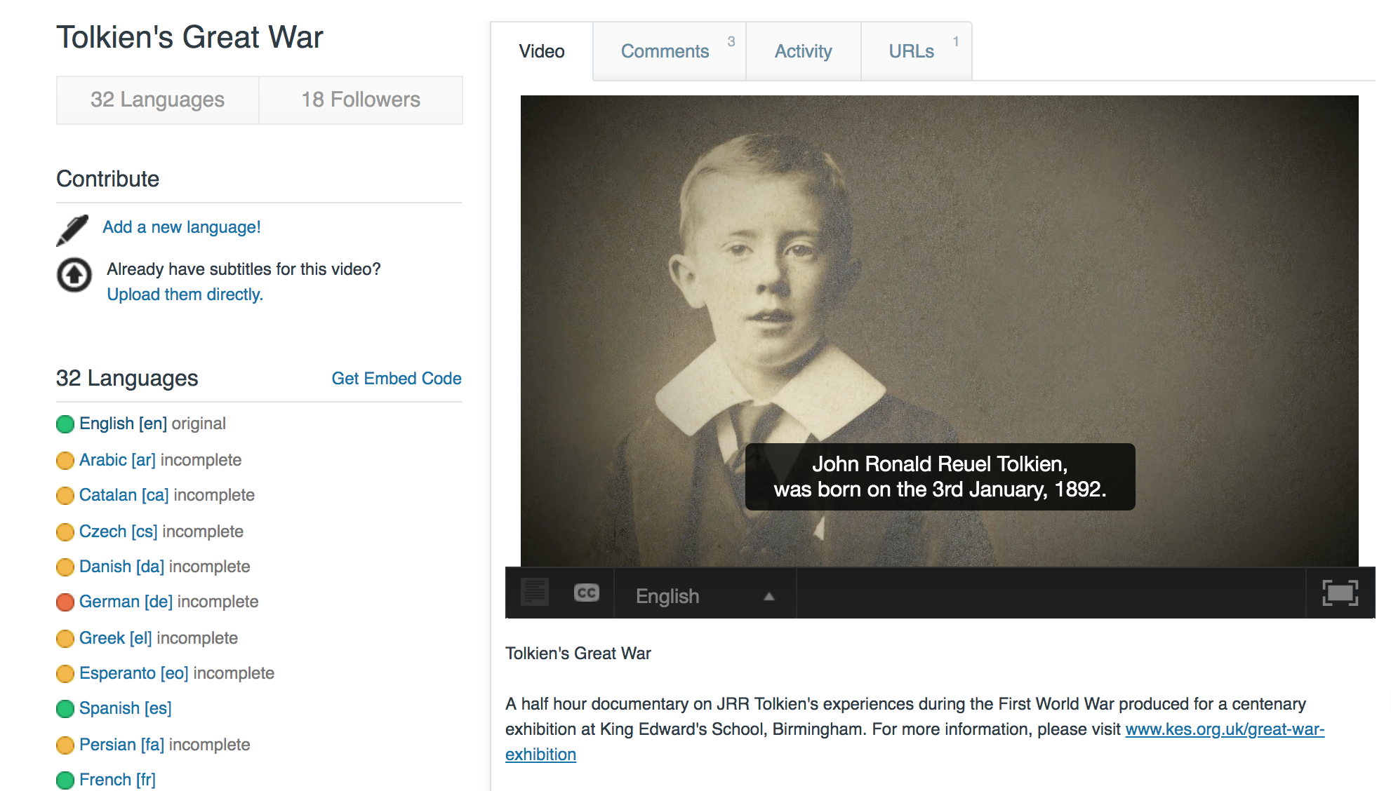
Amara: For Videos You Don’t Own
Multiple video sources, but with a “wrapper” the displays the captions synchronized with the video

Slide 27
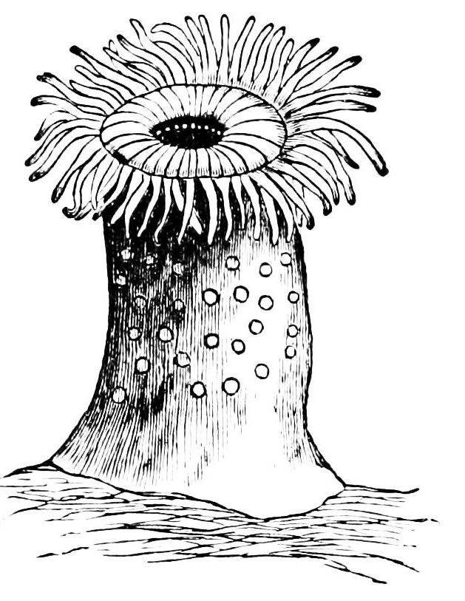
Sea Anemone Anatomy
Tentacles
Mouth
Column
Notes:
Let’s talk about the sea anemone anatomy in detail.
There are three major parts to a sea anemone: the tentacles, the mouth, and the column.
The tentacles line the mouth, which is connected to the main body called the column. If the sea anemone can detach from its substrate like a rock, the column wiggles back and forth to allow it to swim away.

Slide 28
More Sessions!
More sessions this week:
Tuesday (March 17), Wednesday (March 18), and Thursday (March 19)
Morning session: 9AM-10AM
Evening session: 6PM-7PM
More sessions next week!
Tuesday (March 24), Wednesday (March 25), Thursday (March 26)
Morning session: 10AM-11AM
Evening session: 3PM-4PM
Notes:
Request training: https://cccaccessibility.org/training/request-campus-training
More hours listed on: https://cvc.edu/about-the-oei/resources/

Slide 29
CVC-OEI Resources CVC-OEI Instructional, Student Services Shared College Resources Information Support Requests & Questions Email support@cvc.edu
Transitioning to Online Environment
Notes:
CVC-OEI Resources
Emergency Preparedness Resources
Instructional, Student Services, and Shared College Resources https://cvc.edu/about-the-oei/resources/
Public Course Design Accessibility Criteria
https://ccconlineed.instructure.com/courses/5462
Request Free CCC Accessibility 3-Session Professional Development Get a group of interested faculty and let’s dive deeper into Canvas and video accessibility:
https://cccaccessibility.org/training/request-campus-training
Free Accessible Course Layout (Simple)
https://lor.instructure.com/resources/a3a5fec6058b49d0974ebf01ac4e7ad6
Free Accessible Course Layout (Multiple Front Pages)
https://lor.instructure.com/resources/b8d948a27fa947ad93078103919acb5f

Slide 30
Refer to Public Course Design Accessibility Criteria for Canvas Accessibility Guidance. Request Free CCC Accessibility 3-Session Professional Development Get a group of interested faculty and let’s dive deeper into Canvas and video accessibility Free Accessible Course Layout (Simple) Free Accessible Course Layout (Multiple Front Pages)
Canvas Accessibility Resources
Notes:
CVC-OEI Resources
Emergency Preparedness Resources
Instructional, Student Services, and Shared College Resources https://cvc.edu/about-the-oei/resources/
Public Course Design Accessibility Criteria
https://ccconlineed.instructure.com/courses/5462
Request Free CCC Accessibility 3-Session Professional Development Get a group of interested faculty and let’s dive deeper into Canvas and video accessibility:
https://cccaccessibility.org/training/request-campus-training
Free Accessible Course Layout (Simple)
https://lor.instructure.com/resources/a3a5fec6058b49d0974ebf01ac4e7ad6
Free Accessible Course Layout (Multiple Front Pages)
https://lor.instructure.com/resources/b8d948a27fa947ad93078103919acb5f

